Slide 1

Electronic Devices and Circuits

Slide 2

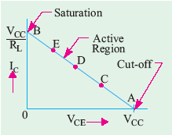

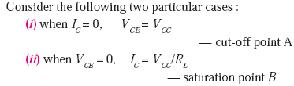
DC Load Line:
Straight line joining two points saturation and cut-off points.
Q-point/Quiescent point:

Slide 3
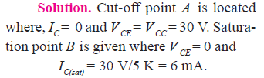
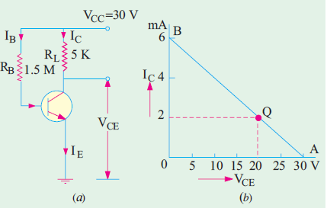
Draw the load line and locate the q-point for the given circuit:

Slide 4
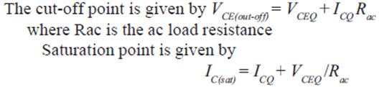
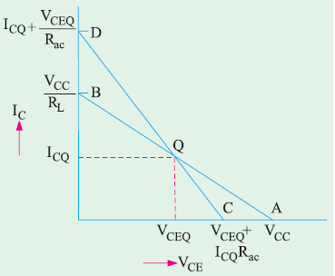
AC Load Line:

Slide 5
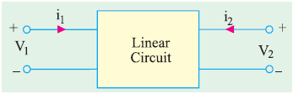

Slide 6

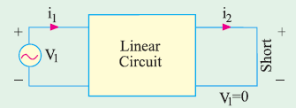
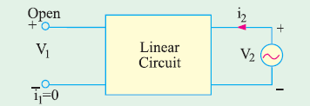


Slide 7
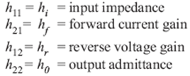


The h-parameters notations for transistor:

Slide 8
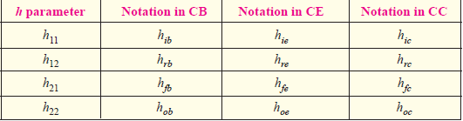
The h-parameters notations for transistor:

Slide 9
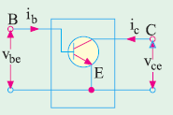
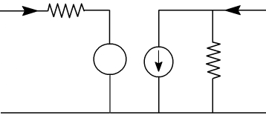
Hybrid Model for CE transistor:

Slide 10
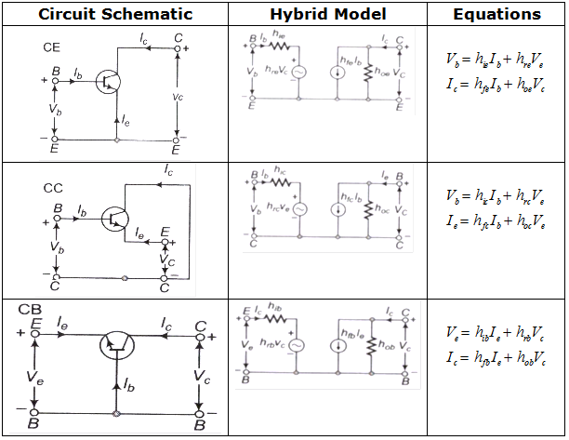

Slide 11
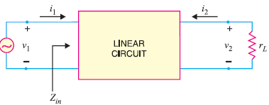

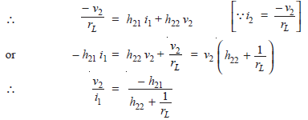
Input impedance, current gain, voltage gain, output impedance and power gain of a 2-port linear circuit in terms of h parameters :
(i)
From Fig., we have
(ii)

Slide 12

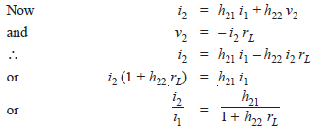

(iii)
(iv)
(v)

Slide 13


(vi)
(vii)
From Eq. (ii) and (vii), we have
(viii)

Slide 14
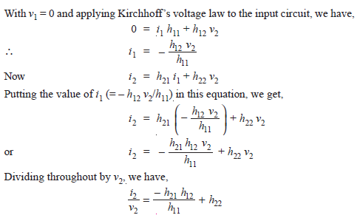

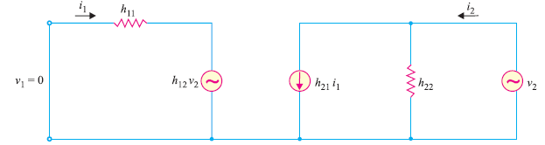
(ix)
(x)

Slide 15
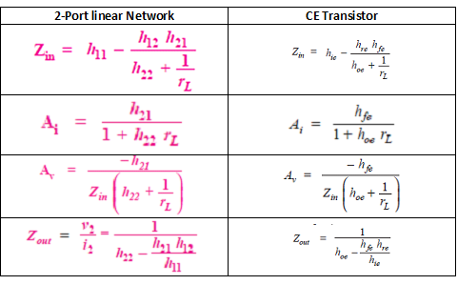

Slide 16
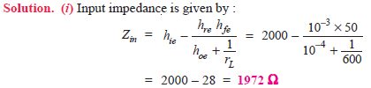



Slide 17

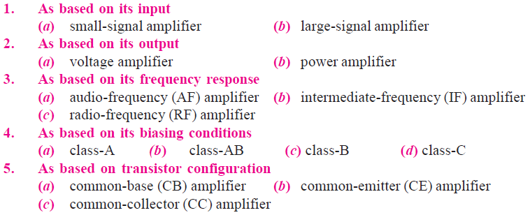

Slide 18
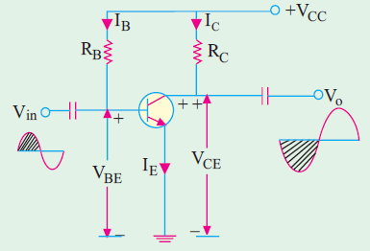
Circuit Operations
When positive half-cycle of the signal is applied:
V_{BE} is increased because it is already positive
w.r.t. the ground.
It leads to increase in forward bias of base-emitter junction.
I_{B} is increased somewhat.
I_{C} is increased by α times the increased in I_{B}.
drop I_{C} R_{C} is increased considerably and consequently.
V_{CE} is decreased as V_{CE} = V_{CC} – I_{C}R_{C} .
Hence, negative half-cycle of the output is obtained. It means that a positive-going input signal becomes a negative going output signal as shown in Fig.

Slide 19
Characteristics of a CE Amplifier
A CE transistor amplifier has the following characteristics :
1. it has moderately low input resistance (1 K to 2 K),
2. its output resistance is moderately large (50 K or so),
3. its current gain (β) is high (50–300),
4. it has very high voltage gain of the order of 1500 or so,
5. it produces very high power gain of the order of 10,000 times or 40 dB,
6. it produces phase reversal of input signal i.e. input and output signals are
180° out of phase with each other.

Slide 20
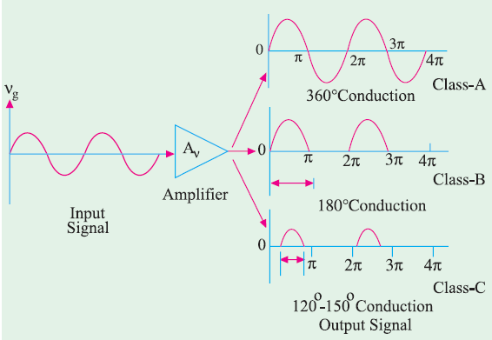
(a) Class-A Amplifier
In this case, the transistor is so biased that output current flows for the full cycle of the input signal (360°) as shown in Fig. (a). Hence, its conduction angle is 360°.
(b) Class-B Amplifier
In this case, the transistor bias and the amplitude of input signal are such that output current flows for only half-cycle (180°) of the input signal. The transistor conduction angle equals 180°.
(c) Class-C Amplifier
In this case, transistor bias and signal amplitude are such that output current flows for appreciably less than half-cycle of the input signal (120 ° to 150°).
(d) Class-AB Amplifier
The characteristics of such an amplifier lie in-between those of class-A and class-B. Here, biasing conditions are such that output current flows for appreciably more than half but less than the entire cycle i.e. current flows for more than 180° but less than 360°.

Slide 21
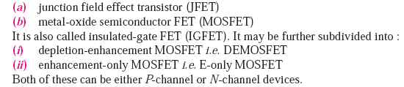
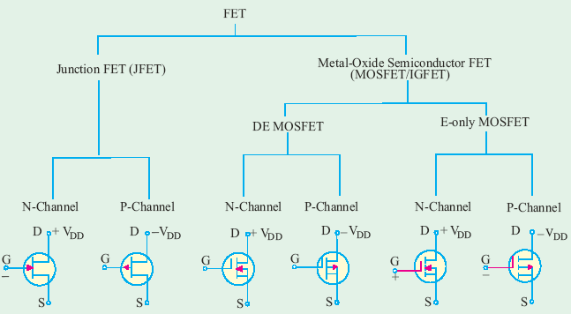
Field Effect Transistor (FET)

Slide 22
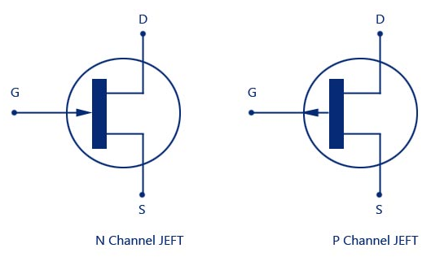
Symbol for JFET:

Slide 23
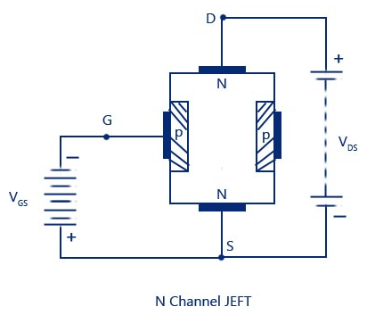
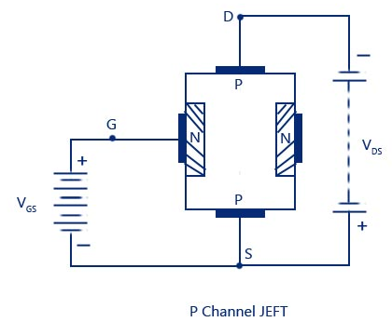

Slide 24
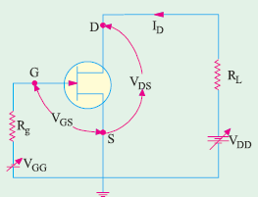
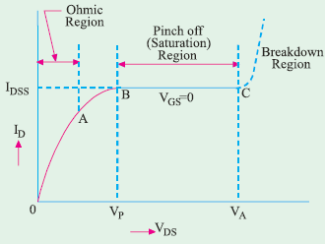
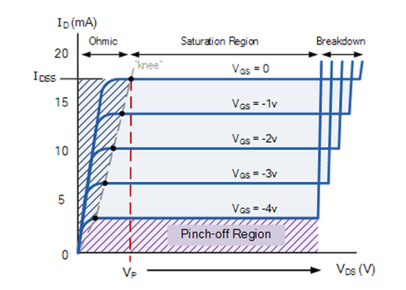

Drain characteristic of a JFET:
Drain current at pinch-off region:

Slide 25
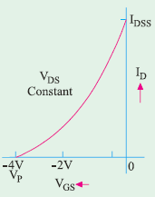


Transfer characteristic of a JFET:

Slide 27
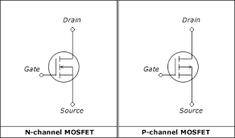

Slide 28
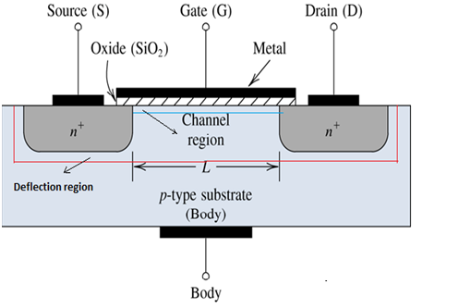

Slide 29
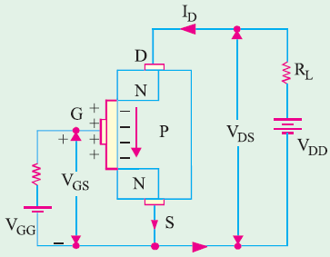
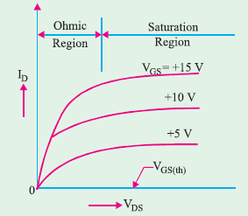
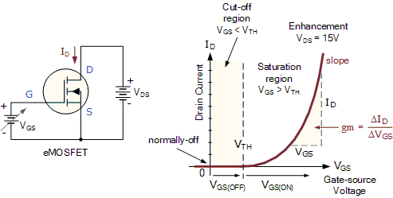
eMOSFET characteristics:

Slide 30
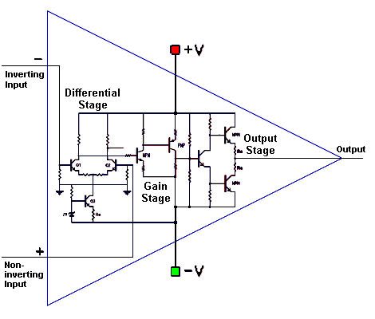
Operational Amplifier (Op-Amp)

Slide 31
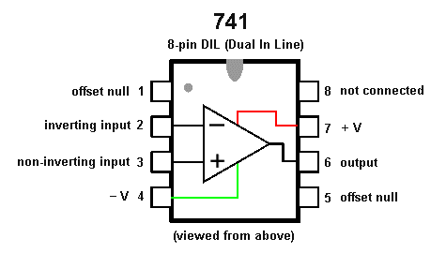

Slide 32
Active Filters:
There are four major types of filters (frequency selective filters):
Low pass filter
High pass filter
Band pass filter
Stop band filter

Slide 33
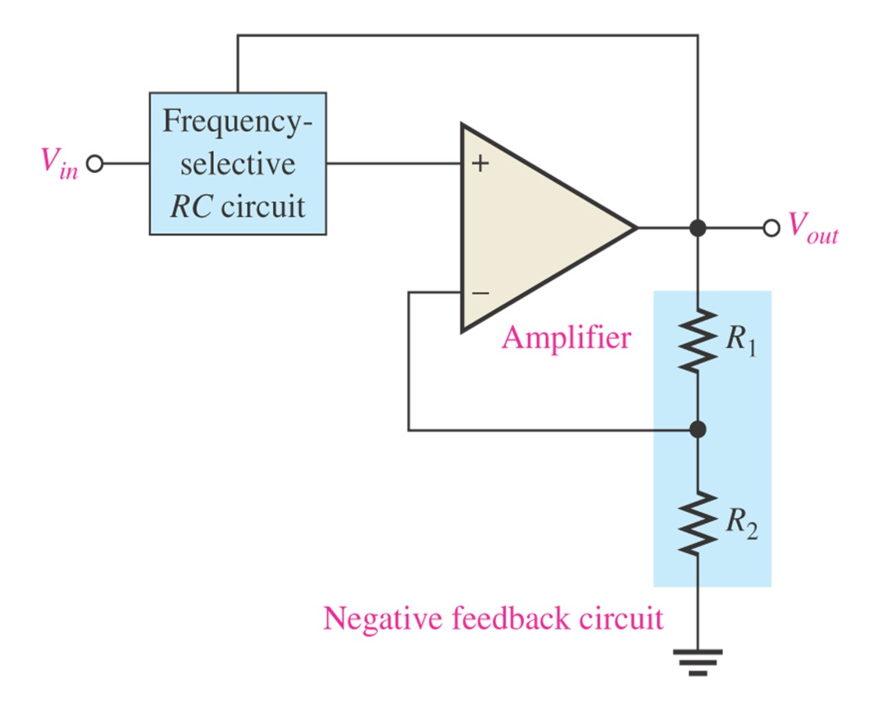
The active filter consists of an amplifier, a negative feedback circuit and RC circuit.
The amplifier and feedback are connected in a non-inverting configuration.
General diagram of an active filter

Slide 34
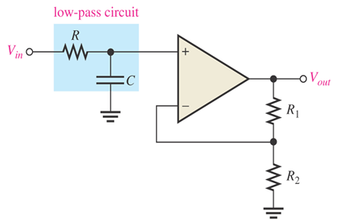
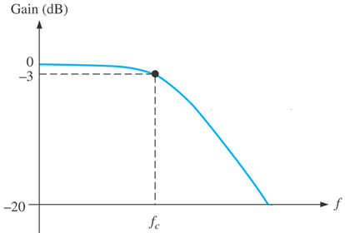
Low Pass Active Filter:
Cut-off frequency of a first-order low pass active filter is:
Frequency response curve

Slide 35
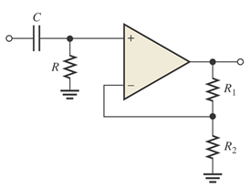
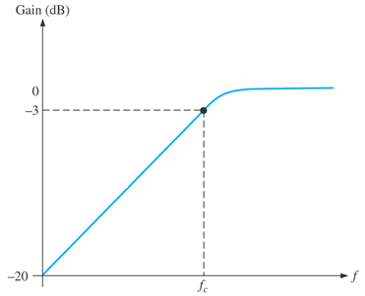
High Pass Active Filter:
Cut-off frequency of a first-order high pass active filter is:
Frequency response curve

